Slide 1
IT2311- Rapid Application Development
Higher National Diploma in Information Technology
Week 1

Slide 2
Module Details
Module Code | HNDIT2311 | Module Title | Rapid Application Development
Credits | 3 | Hours /Week | Lectures | 15
GPA/NGPA | GPA |  | Lab/Tutorial | 60
Semester | 3 | Module Type | Compulsory for Developer track option

Slide 3
Module Aims & Objectives
To provide a firm foundation on Rapid Application Development concepts to familiarize with software development using common RAD tools and environments.
To develop skills and knowledge required for development and deployment RAD Project in Real Time

Slide 4
Learning Out come
Explain Rapid Application Development (RAD) concepts
Determine environments where RAD is suitable and applicable
Use RAD tools and environments for software application development
Develop Project using RAD tools

Slide 5
Assessment Weight
Type | Activity | Weighting
Continuous Assessment | In class participation and quizzes | 10%
 | Self-directed RAD Development Project | 40%
End of semester examination | Structures question paper | 50%

Slide 6
Reference
Internet Resources:
http://msdn.microsoft.com/en-us/library/2x7h1hfk.aspx
Text Books
Whitten, Jeffrey L.; Lonnie D. Bentley, Kevin C. Dittman. (2004). Systems Analysis and Design methods. 6th edition. ISBN 025619906X.
Steven McConnell, Rapid Development, WP Publishers & Distributors (P) Ltd. ISBN: 81-7853-013-9

Slide 7
IT3210- Rapid Application Development
Week 1-History of RAD

Slide 8
What is RAD ?
RAD refers to a development life cycle designed
Compare to traditional life cycle it is Faster development with
higher quality systems
It is designed to take advantage of powerful development software like:
CASE tools (Computer-Aided Software Engineering)
Prototyping tools
Code generators
The key objectives of RAD are: High Speed
High Quality
Low Cost

Slide 9
Continue…
RAD is a people-centered and incremental development aapproach.
Aactive user involvement
all stakeholders
testing is included , system is tested & reviewed by both developers & user
In short RAD thus enables quality products to be developed faster, saving valuable resources.

Slide 10
Why We Need RAD?
Tools and techniques to restructure the process of building information systems
Expand to the entire IS organization,
Replaces hand-design and coding processes
Faster and less error level than hand coding.
Notes:
RAD takes advantage of tools and techniques to restructure the process of building information systems

Slide 11
Traditional Development Issues
Cost and schedule overruns
Product not fit for business
High workload
Projects get cancelled
Friction among managers, developers and customers

Slide 12
Reasons for Project Failures
Risks associated with teams
Risks associated with technology
Risks associated with requirements

Slide 13
Conventional Methods!
Long delay before customer sees the result
Development takes longer time and business may change meanwhile
There is nothing until the entire project is finished

Slide 14
THE HISTORY OF RAD
Traditional lifecycles develop in the 1970s, and still widely used today.
The requirements and design are then frozen and the system is coded, tested, and implemented.

Slide 15
Why Use The RAD ?
RAD compresses the step-by-step development of conventional methods into an iterative process.
The RAD approach includes
developing and refining the data models
process models
prototype in parallel using an iterative process
User requirements are
developed
a solution is designed
the solution is prototyped
the prototype is reviewed
user input is provided
the process begins again

Slide 16
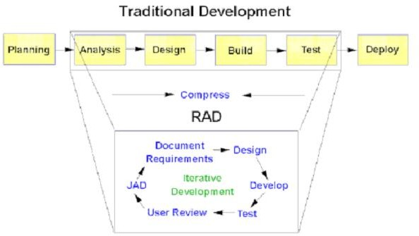

Slide 17
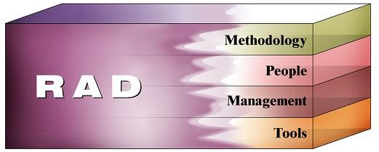
Essential Aspects of RAD
Rapid Application Development has four essential aspects:
Methodology
People
Management
Tools

Slide 18
Classic Mistakes
People related
Product related
Technology related
Process related

Slide 19
People Related Mistakes
Undermined motivation
Weak personnel
Employee problems
Heroics
Unrealistic expectations
Noisy offices
Adding people to a late project
Friction between customers and developers

Slide 20
Product Related Mistakes
Requirements gold plating
Developer gold plating
Feature creep
Changes of the requirements occur for a long period of time
Push me….Pull me negotiation
Research oriented development

Slide 21
Technology Related Mistakes
Silver Bullet Syndrome
Too much rely on new technologies
Switching tools at the middle of the project
Learning curve, rework
Overestimated savings from new tools or methods
Lack of automated source code control

Slide 22
Process Related Mistakes
Lack of risk management
Contractor failure
Lack of planning
Premature convergence
Planning to catch up later
Code like hell programming
Wastage of time at the fuzzy front end

Slide 23
5. Conclusion
RAD has successfully achieved the objective of reducing costs on project whilst not compromising on quality.
Encouraging the involvement of customers in the entire process of its development lifecycle.
RAD has also demonstrated strength in being able to speed up the development process by appropriately combine its methodology, people, management and high tech computer aided tools.
RAD has also proven to have challenges.

